Slide 1
Stock Prices and News
Predicting the Dow Jones Index with Top News Headlines
Nikhil Agarwal
Arun Mistry
Tri Minh Duong

Slide 2
Introduction
Objective:
To predict the tomorrow’s stock movement of DJIA based on the yesterday stock data and news as well as the changes of price last few days.
Data Source:
https://github.com/ShreyamsJain/Stock-Price-Prediction-Model/tree/master/Sentence_Polarity
combined_stock_data.csv – top 25 hottest posts on Reddit daily and the general sentiment analysis
DJIA_table.csv – historical stock data of DJIA

Slide 3
Data introduction
Combined stock data:
Date
Label
Top1 to Top 25
Subjectivity
Objectivity
Positive
Negative
Neutral
DJIA table data:
Date
Open
Close
High
Low
Adjust Close
Volume

Slide 4
Data preparation
New data fields:
Change_yest
Change_2day
Change_3day
Change_2day_Trend
Change_3day_Trend

Slide 5
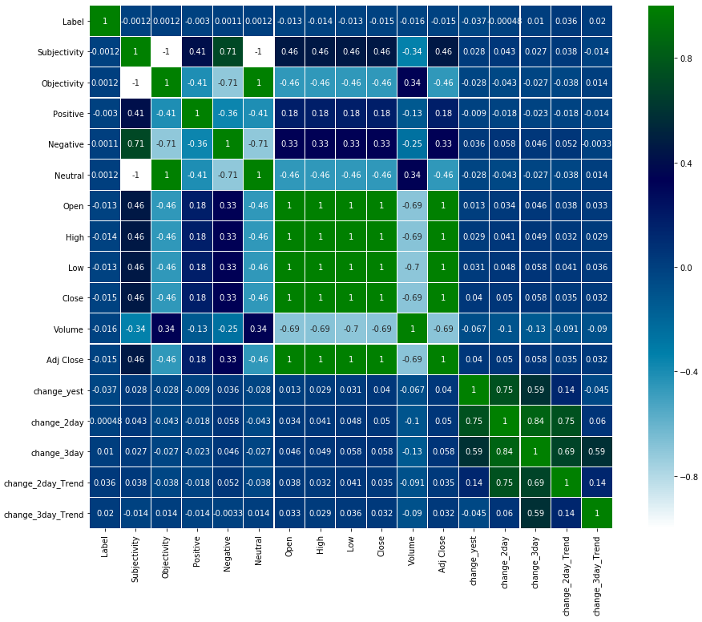
Data Visualization

Slide 6
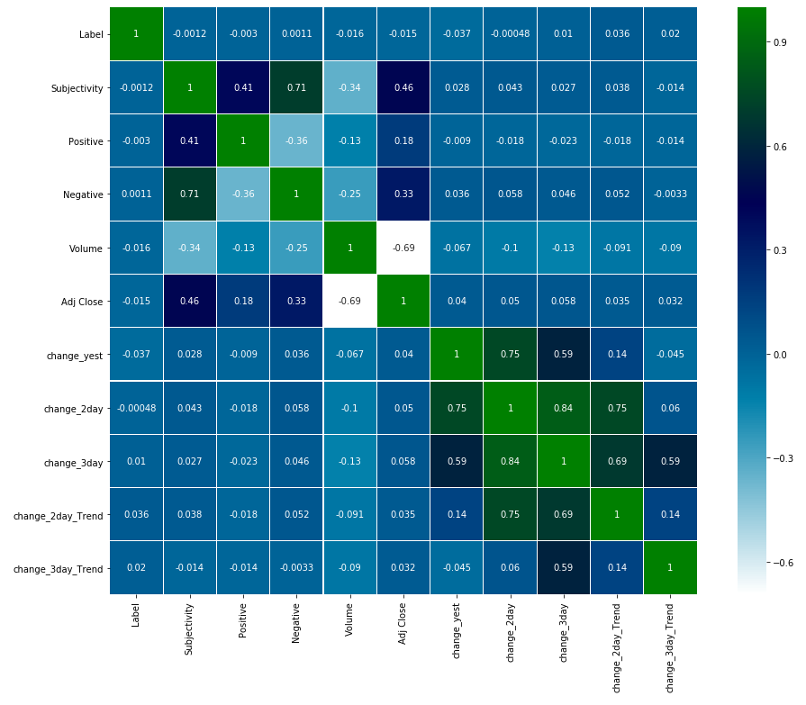
Data visualization
Feature selection

Slide 7
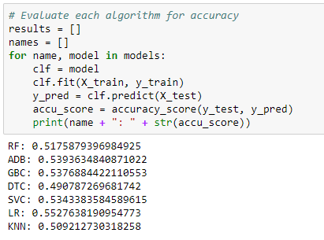
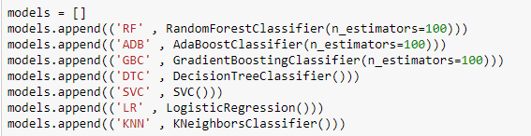
Model Selection
Before fine tuning and additional modeling
We tried 7 models and compared their scores

Slide 8
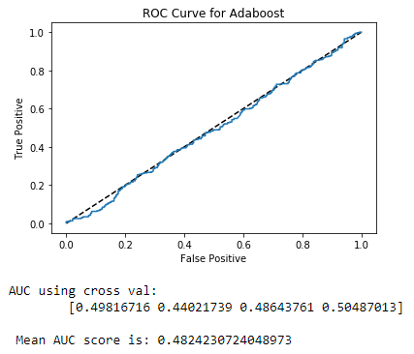
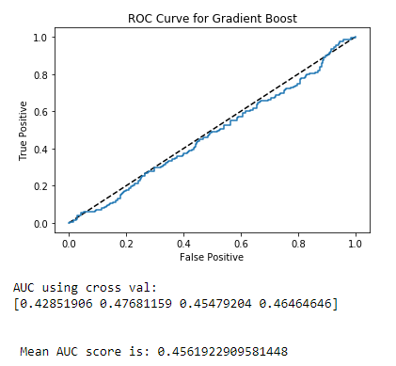
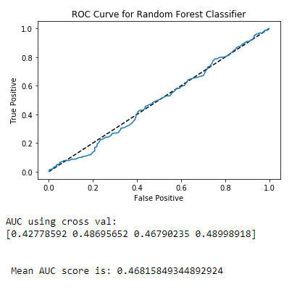
Hyper Tuning models

Slide 9
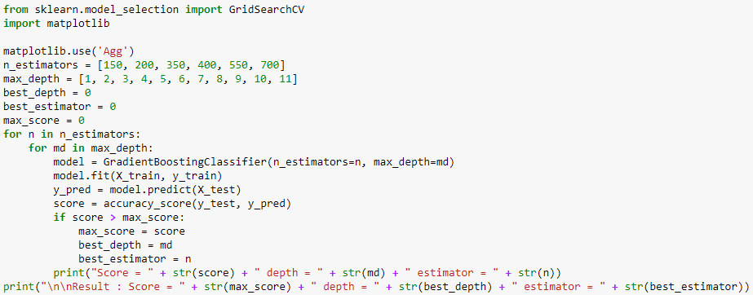
Model Hyper Tuning
We then did further analysis and hyper tuning to try and further improve the score on 5 of the models

Slide 10
Conclusion
Our best score using the various models was 0.55
This is not really strong enough to make money predicting the stock market
but show we can do better then flipping a coin…marginally
Next steps would be to build more features and get multiple sources of data for the news inputs
Try and predict specific stocks instead of the index which is more stable
Higher volatility might be easier to predict using sentiment analysis

